Slide 1
Chapter 1 Introduction to Computers, Programs, and Java

Slide 2
Objectives
To understand computer basics, programs, and operating systems (§§1.2–1.4).
To describe the relationship between Java and the World Wide Web (§1.5).
To understand the meaning of Java language specification, API, JDK, and IDE (§1.6).
To write a simple Java program (§1.7).
To display output on the console (§1.7).
To explain the basic syntax of a Java program (§1.7).
To create, compile, and run Java programs (§1.8).
To use sound Java programming style and document programs properly (§1.9).
To explain the differences between syntax errors, runtime errors, and logic errors (§1.10).
To develop Java programs using NetBeans (§1.11).
To develop Java programs using Eclipse (§1.12).

Slide 3
What is a Computer?
A computer consists of a CPU, memory, hard disk, floppy disk, monitor, printer, and communication devices.

Slide 4
CPU
The central processing unit (CPU) is the brain of a computer. It retrieves instructions from memory and executes them. The CPU speed is measured in megahertz (MHz), with 1 megahertz equaling 1 million pulses per second. The speed of the CPU has been improved continuously. If you buy a PC now, you can get an Intel Pentium 4 Processor at 3 gigahertz (1 gigahertz is 1000 megahertz).

Slide 5
Memory
Memory is to store data and program instructions for CPU to execute. A memory unit is an ordered sequence of bytes, each holds eight bits. A program and its data must be brought to memory before they can be executed. A memory byte is never empty, but its initial content may be meaningless to your program. The current content of a memory byte is lost whenever new information is placed in it.

Slide 6
How Data is Stored?
Data of various kinds, such as numbers, characters, and strings, are encoded as a series of bits (zeros and ones). Computers use zeros and ones because digital devices have two stable states, which are referred to as zero and one by convention. The programmers need not to be concerned about the encoding and decoding of data, which is performed automatically by the system based on the encoding scheme. The encoding scheme varies. For example, character ‘J’ is represented by 01001010 in one byte. A small number such as three can be stored in a single byte. If computer needs to store a large number that cannot fit into a single byte, it uses a number of adjacent bytes. No two data can share or split a same byte. A byte is the minimum storage unit.

Slide 7
Storage Devices
Memory is volatile, because information is lost when the power is off. Programs and data are permanently stored on storage devices and are moved to memory when the computer actually uses them. There are three main types of storage devices:Disk drives (hard disks and floppy disks), CD drives (CD-R and CD-RW), and Tape drives.

Slide 8
Output Devices: Monitor
The monitor displays information (text and graphics). The resolution and dot pitch determine the quality of the display.

Slide 9
Monitor Resolution and Dot Pitch
resolution
The screen resolution specifies the number of pixels in horizontal and vertical dimensions of the display device. Pixels (short for “picture elements”) are tiny dots that form an image on the screen. A common resolution for a 17-inch screen, for example, is 1,024 pixels wide and 768 pixels high. The resolution can be set manually. The higher the resolution, the sharper and clearer the image is.
dot pitch
The dot pitch is the amount of space between pixels, measured in millimeters. The smaller the dot pitch, the sharper the display.

Slide 10
Communication Devices
A regular modem uses a phone line and can transfer data in a speed up to 56,000 bps (bits per second). A DSL (digital subscriber line) also uses a phone line and can transfer data in a speed 20 times faster than a regular modem. A cable modem uses the TV cable line maintained by the cable company. A cable modem is as fast as a DSL. Network interface card (NIC) is a device to connect a computer to a local area network (LAN). The LAN is commonly used in business, universities, and government organizations. A typical type of NIC, called 10BaseT, can transfer data at 10 mbps (million bits per second).

Slide 11
Programs
Computer programs, known as software, are instructions to the computer.
You tell a computer what to do through programs. Without programs, a computer is an empty machine. Computers do not understand human languages, so you need to use computer languages to communicate with them.
Programs are written using programming languages.

Slide 12
Programming Languages
Machine Language Assembly Language High-Level Language
Machine language is a set of primitive instructions built into every computer. The instructions are in the form of binary code, so you have to enter binary codes for various instructions. Program with native machine language is a tedious process. Moreover the programs are highly difficult to read and modify. For example, to add two numbers, you might write an instruction in binary like this:
1101101010011010

Slide 13
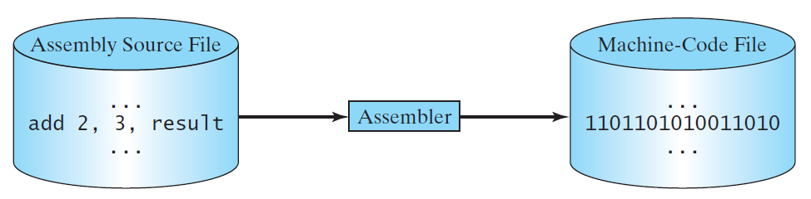
Programming Languages
Machine Language Assembly Language High-Level Language
Assembly languages were developed to make programming easy. Since the computer cannot understand assembly language, however, a program called assembler is used to convert assembly language programs into machine code. For example, to add two numbers, you might write an instruction in assembly code like this:
ADDF3 R1, R2, R3

Slide 14
Programming Languages
Machine Language Assembly Language High-Level Language
The high-level languages are English-like and easy to learn and program. For example, the following is a high-level language statement that computes the area of a circle with radius 5:
area = 5 * 5 * 3.1415;

Slide 15
Popular High-Level Languages

Slide 16
☑ Check Point
What is an assembly language?
What is an assembler?
<--- ANSWER --->
Assembly language is a low-level programming language in which a mnemonic is used to represent each of the machine language instructions.
Assembler is a software that translates assembly language into machine language.

Slide 17
Interpreting/Compiling Source Code
A program written in a high-level language is called a source program or source code. Because a computer cannot understand a source program, a source program must be translated into machine code for execution. The translation can be done using another programming tool called an interpreter or a compiler.

Slide 18
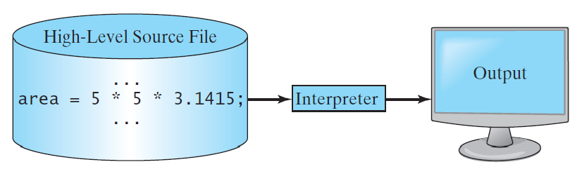
Interpreting Source Code
An interpreter reads one statement from the source code, translates it to the machine code or virtual machine code, and then executes it right away, as shown in the following figure. Note that a statement from the source code may be translated into several machine instructions.

Slide 19
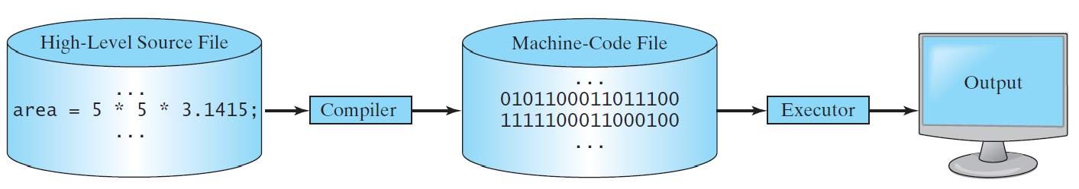
Compiling Source Code
A compiler translates the entire source code into a machine-code file, and the machine-code file is then executed, as shown in the following figure.

Slide 20
☑ Check Point
What is an interpreter?
What is a compiler?
<--- ANSWER --->
An interpreter is a software that reads one statement from the source code, translates it to the machine code or virtual machine code, and then executes it right away.
A compiler is a software that translates a program in high-level language into machine language code.

Slide 21
☑ Check Point
What is the difference between an interpreted language and a compiled language?
<--- ANSWER --->
An interpreter reads one statement from the source code, and translates it to the machine code or virtual machine code, and then executes it right away. A compiler translates the entire source code into a machine code file, and the machine code file is then executed.

Slide 22
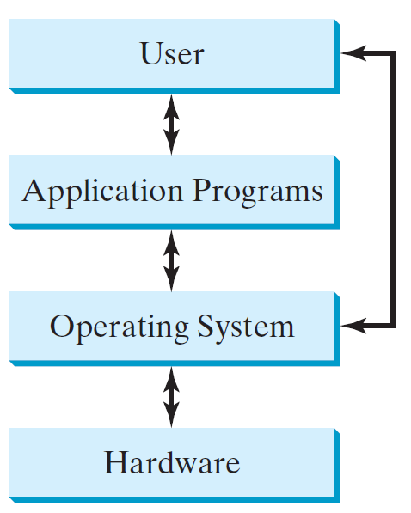
Operating Systems
The operating system (OS) is a program that manages and controls a computer’s activities. The popular operating systems for general-purpose computers are Microsoft Windows, Mac OS, and Linux. Application programs, such as a Web browser or a word processor, cannot run unless an operating system is installed and running on the computer.

Slide 23
Why Java?
The answer is that Java enables users to develop and deploy applications on the Internet for servers, desktop computers, and small hand-held devices. The future of computing is being profoundly influenced by the Internet, and Java promises to remain a big part of that future. Java is the Internet programming language.
Java is a general purpose programming language.
Java is the Internet programming language.

Slide 24
☑ Check Point
What are multiprogramming, multithreading, and multiprocessing?
<--- ANSWER --->
Multiprogramming allows multiple programs to run simultaneously by sharing the CPU. Multithreading allows concurrency within a program, so that its subtasks can run at the same time. Multiprocessing, or parallel processing, uses two or more processors together to perform a task.

Slide 25
Java, Web, and Beyond
Java can be used to develop standalone applications.
Java can be used to develop applications running from a browser.
Java can also be used to develop applications for hand-held devices.
Java can be used to develop applications for Web servers.

Slide 26
Java’s History
James Gosling and Sun Microsystems
Oak
Java, May 20, 1995, Sun World
HotJava
The first Java-enabled Web browser
Early History Website:
http://www.java.com/en/javahistory/index.jsp

Slide 27
Characteristics of Java
Companion Website
Java Is Simple
Java Is Object-Oriented
Java Is Distributed
Java Is Interpreted
Java Is Robust
Java Is Secure
Java Is Architecture-Neutral
Java Is Portable
Java's Performance
Java Is Multithreaded
Java Is Dynamic
www.cs.armstrong.edu/liang/JavaCharacteristics.pdf

Slide 28
Characteristics of Java
Companion Website
Java Is Simple
Java Is Object-Oriented
Java Is Distributed
Java Is Interpreted
Java Is Robust
Java Is Secure
Java Is Architecture-Neutral
Java Is Portable
Java's Performance
Java Is Multithreaded
Java Is Dynamic
Java is partially modeled on C++, but greatly simplified and improved. Some people refer to Java as "C++--" because it is like C++ but with more functionality and fewer negative aspects.

Slide 29
Characteristics of Java
Companion Website
Java Is Simple
Java Is Object-Oriented
Java Is Distributed
Java Is Interpreted
Java Is Robust
Java Is Secure
Java Is Architecture-Neutral
Java Is Portable
Java's Performance
Java Is Multithreaded
Java Is Dynamic
Java is inherently object-oriented. Although many object-oriented languages began strictly as procedural languages, Java was designed from the start to be object-oriented. Object-oriented programming (OOP) is a popular programming approach that is replacing traditional procedural programming techniques.
One of the central issues in software development is how to reuse code. Object-oriented programming provides great flexibility, modularity, clarity, and reusability through encapsulation, inheritance, and polymorphism.

Slide 30
Characteristics of Java
Companion Website
Java Is Simple
Java Is Object-Oriented
Java Is Distributed
Java Is Interpreted
Java Is Robust
Java Is Secure
Java Is Architecture-Neutral
Java Is Portable
Java's Performance
Java Is Multithreaded
Java Is Dynamic
Distributed computing involves several computers working together on a network. Java is designed to make distributed computing easy. Since networking capability is inherently integrated into Java, writing network programs is like sending and receiving data to and from a file.

Slide 31
Characteristics of Java
Companion Website
Java Is Simple
Java Is Object-Oriented
Java Is Distributed
Java Is Interpreted
Java Is Robust
Java Is Secure
Java Is Architecture-Neutral
Java Is Portable
Java's Performance
Java Is Multithreaded
Java Is Dynamic
You need an interpreter to run Java programs. The programs are compiled into the Java Virtual Machine code called bytecode. The bytecode is machine-independent and can run on any machine that has a Java interpreter, which is part of the Java Virtual Machine (JVM).

Slide 32
Characteristics of Java
Companion Website
Java Is Simple
Java Is Object-Oriented
Java Is Distributed
Java Is Interpreted
Java Is Robust
Java Is Secure
Java Is Architecture-Neutral
Java Is Portable
Java's Performance
Java Is Multithreaded
Java Is Dynamic
Java compilers can detect many problems that would first show up at execution time in other languages.
Java has eliminated certain types of error-prone programming constructs found in other languages.
Java has a runtime exception-handling feature to provide programming support for robustness.

Slide 33
Characteristics of Java
Companion Website
Java Is Simple
Java Is Object-Oriented
Java Is Distributed
Java Is Interpreted
Java Is Robust
Java Is Secure
Java Is Architecture-Neutral
Java Is Portable
Java's Performance
Java Is Multithreaded
Java Is Dynamic
Java implements several security mechanisms to protect your system against harm caused by stray programs.

Slide 34
Characteristics of Java
Companion Website
Java Is Simple
Java Is Object-Oriented
Java Is Distributed
Java Is Interpreted
Java Is Robust
Java Is Secure
Java Is Architecture-Neutral
Java Is Portable
Java's Performance
Java Is Multithreaded
Java Is Dynamic
Write once, run anywhere
With a Java Virtual Machine (JVM), you can write one program that will run on any platform.

Slide 35
Characteristics of Java
Companion Website
Java Is Simple
Java Is Object-Oriented
Java Is Distributed
Java Is Interpreted
Java Is Robust
Java Is Secure
Java Is Architecture-Neutral
Java Is Portable
Java's Performance
Java Is Multithreaded
Java Is Dynamic
Because Java is architecture neutral, Java programs are portable. They can be run on any platform without being recompiled.

Slide 36
Characteristics of Java
Companion Website
Java Is Simple
Java Is Object-Oriented
Java Is Distributed
Java Is Interpreted
Java Is Robust
Java Is Secure
Java Is Architecture-Neutral
Java Is Portable
Java's Performance
Java Is Multithreaded
Java Is Dynamic
Java’s performance Because Java is architecture neutral, Java programs are portable. They can be run on any platform without being recompiled.

Slide 37
Characteristics of Java
Companion Website
Java Is Simple
Java Is Object-Oriented
Java Is Distributed
Java Is Interpreted
Java Is Robust
Java Is Secure
Java Is Architecture-Neutral
Java Is Portable
Java's Performance
Java Is Multithreaded
Java Is Dynamic
Multithread programming is smoothly integrated in Java, whereas in other languages you have to call procedures specific to the operating system to enable multithreading.

Slide 38
Characteristics of Java
Companion Website
Java Is Simple
Java Is Object-Oriented
Java Is Distributed
Java Is Interpreted
Java Is Robust
Java Is Secure
Java Is Architecture-Neutral
Java Is Portable
Java's Performance
Java Is Multithreaded
Java Is Dynamic
Java was designed to adapt to an evolving environment. New code can be loaded on the fly without recompilation. There is no need for developers to create, and for users to install, major new software versions. New features can be incorporated transparently as needed.

Slide 39
☑ Check Point
Is Java case sensitive?
What is the case for Java keywords?
<--- ANSWER --->
Java source code is case sensitive.
Java keywords are always in lowercase.

Slide 40
JDK Versions
JDK 1.02 (1995)
JDK 1.1 (1996)
JDK 1.2 (1998)
JDK 1.3 (2000)
JDK 1.4 (2002)
JDK 1.5 (2004) a. k. a. JDK 5 or Java 5
JDK 1.6 (2006) a. k. a. JDK 6 or Java 6
JDK 1.7 (2011) a. k. a. JDK 7 or Java 7
JDK 1.8 (2014) a. k. a. JDK 8 or Java 8

Slide 41
JDK Editions
Java Standard Edition (J2SE)
J2SE can be used to develop client-side standalone applications or applets.
Java Enterprise Edition (J2EE)
J2EE can be used to develop server-side applications such as Java servlets, Java ServerPages, and Java ServerFaces.
Java Micro Edition (J2ME).
J2ME can be used to develop applications for mobile devices such as cell phones.
This book uses J2SE to introduce Java programming.

Slide 42
Popular Java IDEs
NetBeans
Eclipse

Slide 43
A Simple Java Program
Listing 1.1
// This program prints Welcome to Java!
public class Welcome {
public static void main(String[] args) {
System.out.println("Welcome to Java!");
}
}
Note: Clicking the green button displays the source code with interactive animation. You can also run the code in a browser. Internet connection is needed for this button.
Welcome
Run
Note: Clicking the blue button runs the code from Windows. If you cannot run the buttons, see liveexample.pearsoncmg.com/slide/javaslidenote.doc.

Slide 44
☑ Check Point
Show the output of the following code: public class Test { public static void main(String[] args) { System.out.println("3.5 * 4 / 2 - 2.5 is "); System.out.println(3.5 * 4 / 2 - 2.5); } }
<--- ANSWER --->
Output is 3.5 * 4 / 2 - 2.5 is 4.5

Slide 45

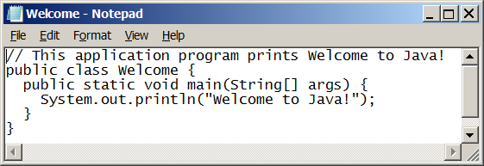
Creating and Editing Using NotePad
To use NotePad, type
notepad Welcome.java
from the DOS prompt.

Slide 46

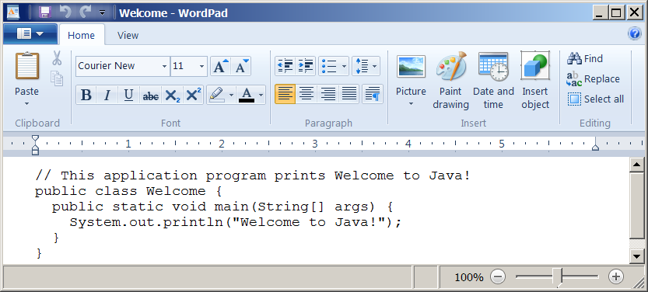
Creating and Editing Using WordPad
To use WordPad, type
write Welcome.java
from the DOS prompt.

Slide 47
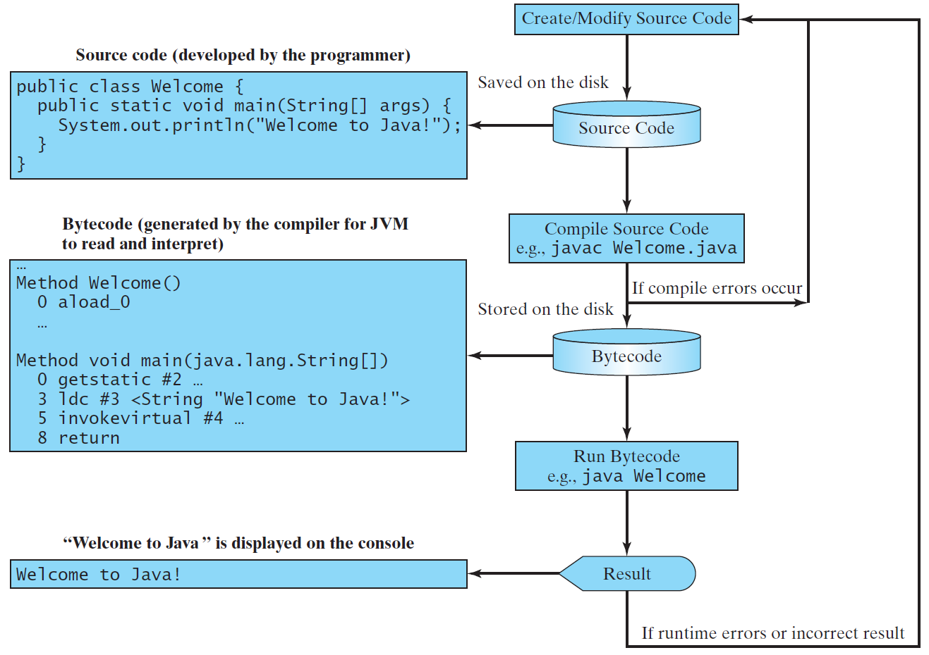
Creating, Compiling, and Running Programs

Slide 48
☑ Check Point
What is the Java source filename extension, and what is the Java bytecode filename extension?
<--- ANSWER --->
The source file extension is .java and the bytecode file extension is .class.

Slide 49
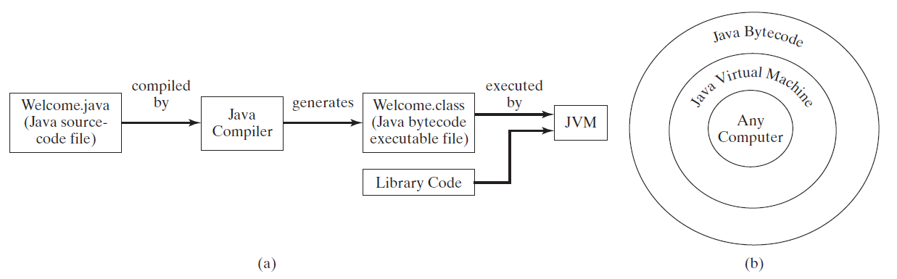
Compiling Java Source Code
You can port a source program to any machine with appropriate compilers. The source program must be recompiled, however, because the object program can only run on a specific machine. Nowadays computers are networked to work together. Java was designed to run object programs on any platform. With Java, you write the program once, and compile the source program into a special type of object code, known as bytecode. The bytecode can then run on any computer with a Java Virtual Machine, as shown below. Java Virtual Machine is a software that interprets Java bytecode.

Slide 50
Trace a Program Execution
animation
Enter main method
// This program prints Welcome to Java!
public class Welcome {
public static void main(String[] args) {
System.out.println("Welcome to Java!");
}
}

Slide 51
Trace a Program Execution
animation
Execute statement
// This program prints Welcome to Java!
public class Welcome {
public static void main(String[] args) {
System.out.println("Welcome to Java!");
}
}

Slide 52
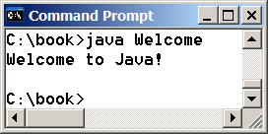
Trace a Program Execution
animation
// This program prints Welcome to Java!
public class Welcome {
public static void main(String[] args) {
System.out.println("Welcome to Java!");
}
}
print a message to the console

Slide 53
Two More Simple Examples
WelcomeWithThreeMessages
Run
ComputeExpression
Run

Slide 54
☑ Check Point
What are the input and output of a Java compiler?
<--- ANSWER --->
The input of a Java compiler is a Java source code file and the output is a Java class file.

Slide 55
Supplements on the Companion Website
Companion Website
See Supplement I.B for installing and configuring JDK
See Supplement I.C for compiling and running Java from the command window for details
www.pearsonhighered.com/liang

Slide 56
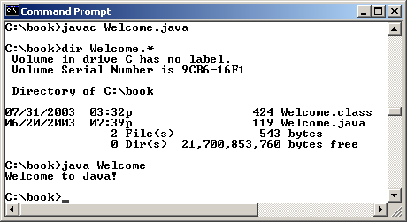
Compiling and Running Java from the Command Window
Companion Website
Set path to JDK bin directory
set path=c:\Program Files\java\jdk1.8.0\bin
Set classpath to include the current directory
set classpath=.
Compile
javac Welcome.java
Run
java Welcome

Slide 57
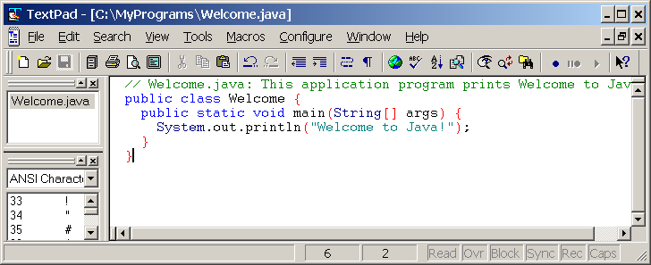
Compiling and Running Java from TextPad
Companion Website
See Supplement II.A on the Website for details

Slide 58
☑ Check Point
What is the command to compile a Java program?
What is the command to run a Java program?
<--- ANSWER --->
javac is the JDK command to compile a program.
java is the JDK command to run a program.

Slide 59
☑ Check Point
Can Java run on any machine? What is needed to run Java on a computer?
<--- ANSWER --->
Java can run on any machine with a JVM.

Slide 60
Anatomy of a Java Program
Class name
Main method
Statements
Statement terminator
Reserved words
Comments
Blocks

Slide 61
Class Name
Every Java program must have at least one class. Each class has a name. By convention, class names start with an uppercase letter. In this example, the class name is Welcome.
// This program prints Welcome to Java!
public class Welcome {
public static void main(String[] args) {
System.out.println("Welcome to Java!");
}
}

Slide 62
Main Method
Line 2 defines the main method. In order to run a class, the class must contain a method named main. The program is executed from the main method.
// This program prints Welcome to Java!
public class Welcome {
public static void main(String[] args) {
System.out.println("Welcome to Java!");
}
}

Slide 63
Statement
A statement represents an action or a sequence of actions. The statement System.out.println("Welcome to Java!") in the program in Listing 1.1 is a statement to display the greeting "Welcome to Java!“.
// This program prints Welcome to Java!
public class Welcome {
public static void main(String[] args) {
System.out.println("Welcome to Java!");
}
}

Slide 64
Statement Terminator
Every statement in Java ends with a semicolon (;).
// This program prints Welcome to Java!
public class Welcome {
public static void main(String[] args) {
System.out.println("Welcome to Java!");
}
}

Slide 65
Reserved words
Reserved words or keywords are words that have a specific meaning to the compiler and cannot be used for other purposes in the program. For example, when the compiler sees the word class, it understands that the word after class is the name for the class.
// This program prints Welcome to Java!
public class Welcome {
public static void main(String[] args) {
System.out.println("Welcome to Java!");
}
}

Slide 66
Blocks
A pair of braces in a program forms a block that groups components of a program.

Slide 67
Special Symbols

Slide 68
{ … }
// This program prints Welcome to Java!
public class Welcome {
public static void main(String[] args) {
System.out.println("Welcome to Java!");
}
}

Slide 69
( … )
// This program prints Welcome to Java!
public class Welcome {
public static void main(String[] args) {
System.out.println("Welcome to Java!");
}
}

Slide 70
;
// This program prints Welcome to Java!
public class Welcome {
public static void main(String[] args) {
System.out.println("Welcome to Java!");
}
}

Slide 71
// …
// This program prints Welcome to Java!
public class Welcome {
public static void main(String[] args) {
System.out.println("Welcome to Java!");
}
}

Slide 72
" … "
// This program prints Welcome to Java!
public class Welcome {
public static void main(String[] args) {
System.out.println("Welcome to Java!");
}
}

Slide 73
Programming Style and Documentation
Appropriate Comments
Naming Conventions
Proper Indentation and Spacing Lines
Block Styles

Slide 74
Appropriate Comments
Include a summary at the beginning of the program to explain what the program does, its key features, its supporting data structures, and any unique techniques it uses.
Include your name, class section, instructor, date, and a brief description at the beginning of the program.

Slide 75
Naming Conventions
Choose meaningful and descriptive names.
Class names:
Capitalize the first letter of each word in the name. For example, the class name ComputeExpression.

Slide 76
Proper Indentation and Spacing
Indentation
Indent two spaces.
Spacing
Use blank line to separate segments of the code.

Slide 77
Block Styles
Use end-of-line style for braces.

Slide 78
Programming Errors
Syntax Errors
Detected by the compiler
Runtime Errors
Causes the program to abort
Logic Errors
Produces incorrect result

Slide 79
Syntax Errors
public class ShowSyntaxErrors {
public static main(String[] args) {
System.out.println("Welcome to Java);
}
}
ShowSyntaxErrors
Run

Slide 80
Runtime Errors
public class ShowRuntimeErrors {
public static void main(String[] args) {
System.out.println(1 / 0);
}
}
ShowRuntimeErrors
Run

Slide 81
Logic Errors
public class ShowLogicErrors {
public static void main(String[] args) {
System.out.println("Celsius 35 is Fahrenheit degree ");
System.out.println((9 / 5) * 35 + 32);
}
}
ShowLogicErrors
Run

Slide 82
☑ Check Point
What are syntax errors (compile errors), runtime errors, and logic errors?
<--- ANSWER --->
Syntax errors are detected by compilers. Runtime errors occur during execution of the program. Logic errors results in incorrect results.

Slide 83
☑ Check Point
If you forget to put a closing quotation mark on a string, what kind error will be raised?
If your program needs to read integers, but the user entered strings, an error would occur when running this program. What kind of error is this?
Suppose you write a program for computing the perimeter of a rectangle and you mistakenly write your program so that it computes the area of a rectangle. What kind of error is this?
<--- ANSWER --->
Syntax error.
Runtime error.
Logic error.

Slide 84
Compiling and Running Java from NetBeans
Companion Website
See Supplement I.D on the Website for details

Slide 85
Compiling and Running Java from Eclipse
Companion Website
See Supplement II.D on the Website for details

Slide 86
☑ Check Point
Identify and fix the errors in the following code: 1 public class Welcome { 2 public void Main(String[] args) { 3 System.out.println('Welcome to Java!'); 4 } 5 )
<--- ANSWER --->
Line 2. Main should be main. Line 2. static is missing. Line 3: Welcome to Java! should be enclosed inside double quotation marks. Line 5: The last ) should be }.

